Slide 1


Orchard Lake Schools
St. Mary’s Preparatory
美国密歇根圣玛丽男子高中

Slide 2
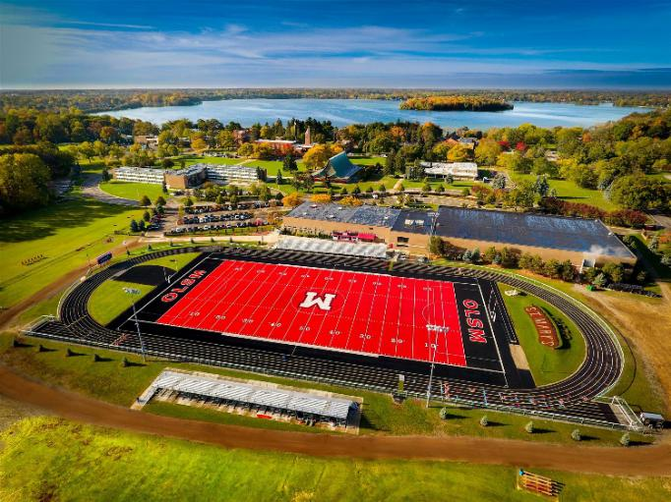
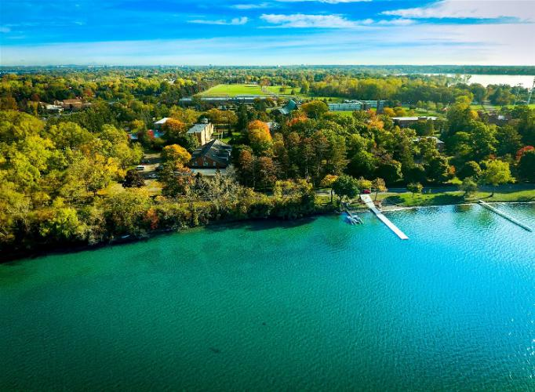
Basic Information
学校基本信息
建校年份: 1885
占地面积: 120 英亩（1 英亩≈ 4047 平方米）
学校性质: 男校
宗教背景: 天主教
年级设置: 9 -12
开放年级: 9 -11
学生总数: 500
中国学生数: 5%
师生比例: 1:14
班级平均人数: 14
住宿方式: 学校宿舍
教师资质:66% 以上教师都拥有硕士及以上学位
奖学金: 往届毕业生获得奖学金大约640 万美元
Founded：1885
Occupied Area：120 acres
Co-Ed or Single Gender: Boys
Affiliation: Roman Catholic
Size: About 500 Students
Chinese Students：6%
Teacher and Student Ratio：1:14
Teacher Education: 66% master degree or higher
Housing：Dormitory building/boarding program
Scholarship：$6,400,000 approx.

Slide 3
History and Mission Statement
历史及教学使命
百年锦绣织日月，树人树德写春秋
The Schools were Founded in 1885 By Fr. Joseph Dabrowski in the city of Detroit. SMP is a Catholic, all-boys, college preparatory high school with a Polish-American heritage and legacy since 1885 A.D. We exist to provide deserving young men the moral guidance, discipline, and education to become Christ-like models of service and leadership for the world. By completion of our spiritual and educational model, these men gain the character, reverence, and fortitude to meet all challenges for the greater glory of God and their alma mater.
始建于公元1885年，以“笃真、严格、刻求真理”遐迩于世的圣玛丽男子高中，不仅是密歇根州的传统精英名校，还是绅士的乐土、高材生的摇篮。133年岁月流岚，虽然时移世易，但圣玛丽的全体教职人员却仍恪守着创始人Joseph Dabrowski 先生“育才先育人”的教学理念，谆谆导学，因材施教，以将学生培养为“正直、理性、成熟、有担当”的高端男子精英人才为己任，且多年来成绩斐然。
密州天主教高中排名 7/40 密州私立高中排名 14/96 密州私立预备高中排名 14/93

Slide 4
Who We Are …
教育理念
育才先育人，育人先培德
SMP is a four year secondary program of pre-college studies in a disciplined environment preparing young men for future study and careers of service and leadership. The Prep has a day student as well as boarding school program. St. Mary‘s is accredited by the State of Michigan Board of Education, the Archdiocese of Detroit, and The Michigan Association of Non-Public Schools.
全面发展式教育，着重于阳光健全开朗的人格塑造及仁爱为善的心灵修养。不仅专注于学习能力培养，同时注重体质等各方面素质强化，培养孩子成为全才。
“以树德为先，为绅士导学”的教育理念，着力为每一位学子都营造一个舒适、健康、自由、快乐的成长环境。亦不忘以严格却不严厉的教规与校规适当的约束学生们的言行举止，以期培养出富有进取精神、成熟、具有卓越领导才华的绅士与领袖。
着重培养执行力、领导力、思维力、决策力，帮助小精英们获得毅力、耐力、尊严、性格、决策、判断等多个领域的素质提升，以完成人生中要面对的种种任务与挑战。

Slide 5
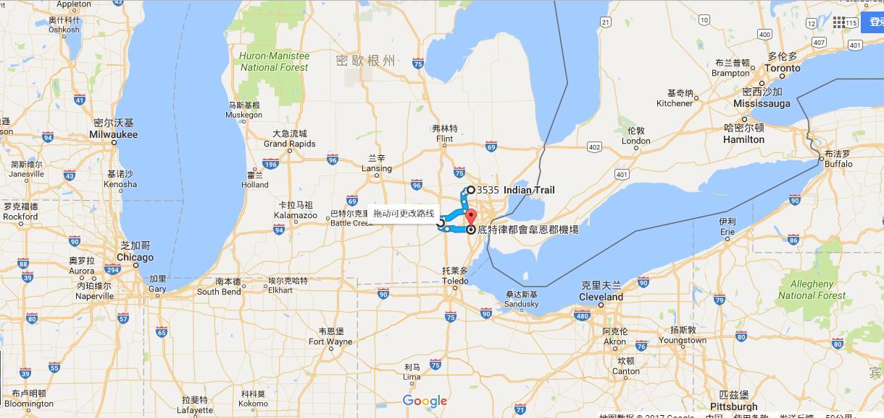
地理位置 Location
St. Mary
圣玛丽男子高中
。 Climate: Michigan has a continental climate with hot summers and cold winters.
15 public universities University of Michigan (Ann Arbor) and Michigan State University are listed as a Public Ivy. University of Michigan ranked as #17 in “global” U.S. News & World Report.
Manufacturing， Agriculture, and Automobile.

Slide 6
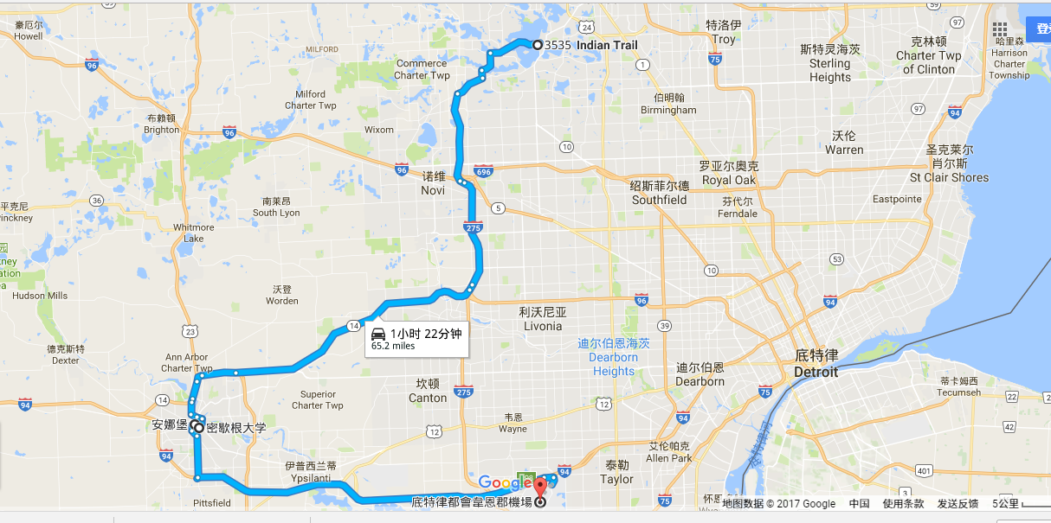
地理位置 Location
St. Mary
圣玛丽男子高中
密歇根大学安娜堡分校
底特律国际机场
Notes:
Note: driving distance

Slide 7

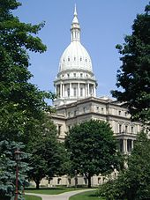
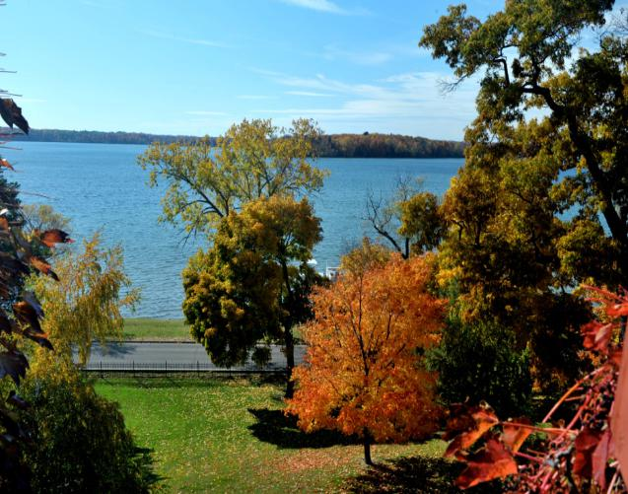
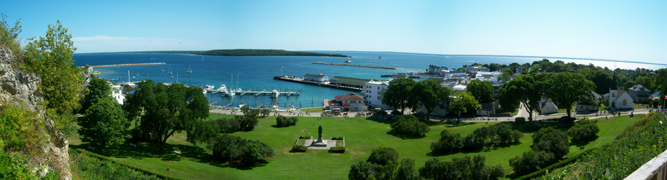
Michigan密歇根风光
Notes:
Top to down:
Skyscrapers in downtown Detroit
Michigan State Capitolin Lansing
Michigan State Capitol Muses
Marquette Park on Mackinac Island

Slide 8
Community and City of Orchard Lake
果园湖 与 西布鲁姆菲尔德
Orchard Lake Village is a city in Midwestern part of U.S.A. It is a small, exclusive suburb of Detroit Michigan. The city is mostly surrounded by West Bloomfield. About 43 percent of the City of Orchard Lake Village is occupied by lakes and ponds. Orchard Lake Village is consistently ranked as the most affluent town in Michigan with a median household income of $153,289.
密歇根州经济发展水平最高的小城之一
家庭收入中位数达到近15万3千美元，全美前10%
犯罪率全美最低之一
“全美最安全社区之一”
“全美最宜居城市” 全美百强榜前十
“CEO高档住宅度假社区”

Slide 9




Surrounding community environment
周边社区环境
Notes:
Top to down:
Skyscrapers in downtown Detroit
Michigan State Capitolin Lansing
Michigan State Capitol Muses
Marquette Park on Mackinac Island

Slide 10


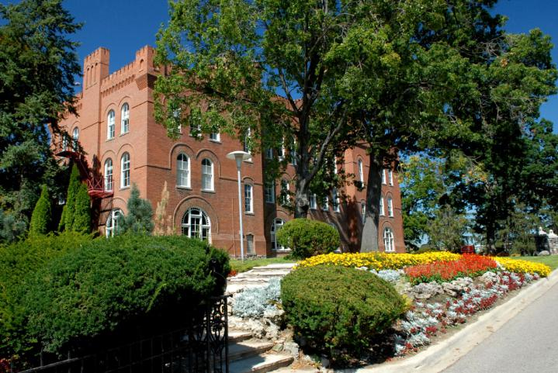
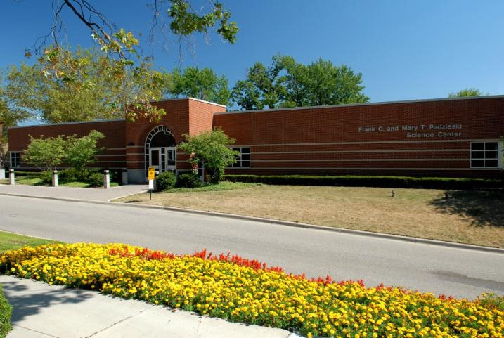
Campus 校园环境

Slide 11
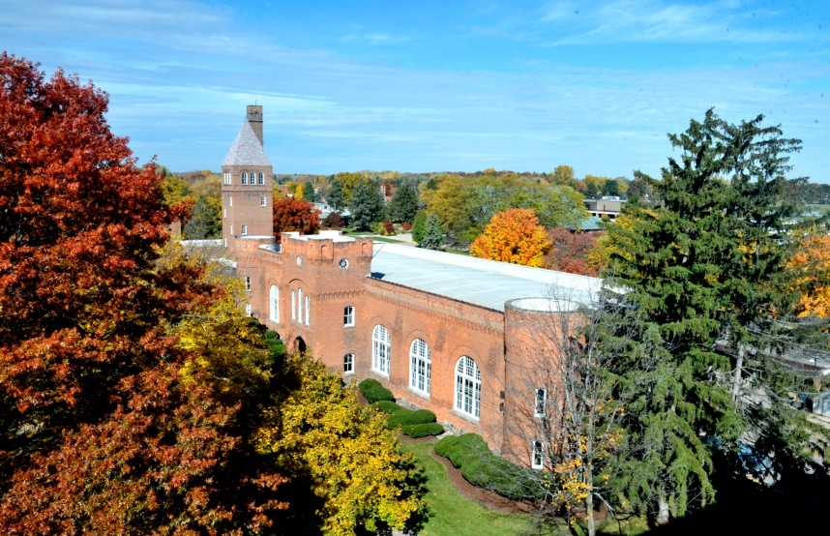
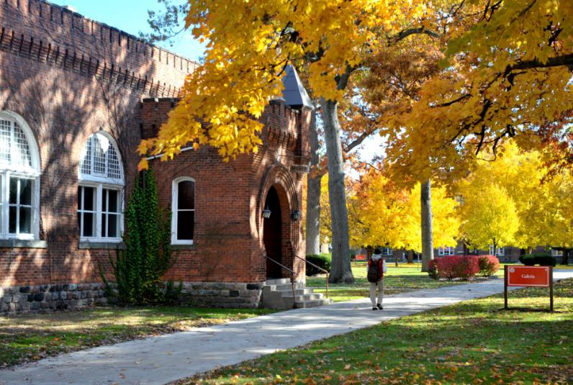
Campus 校园环境

Slide 12
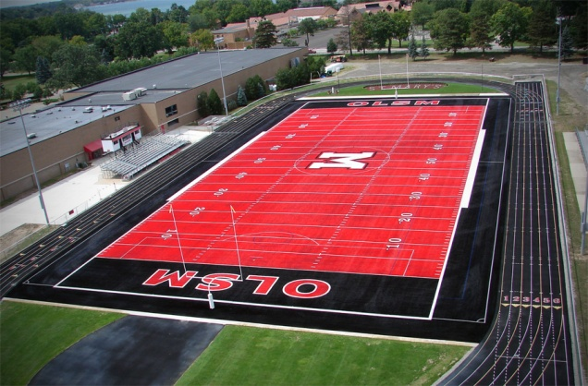
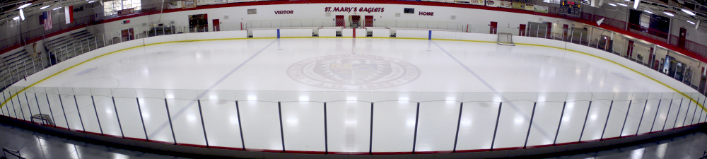
Impressive Facilities 顶尖设施
Football Field 橄榄球场
Ice Arena 冰场

Slide 13

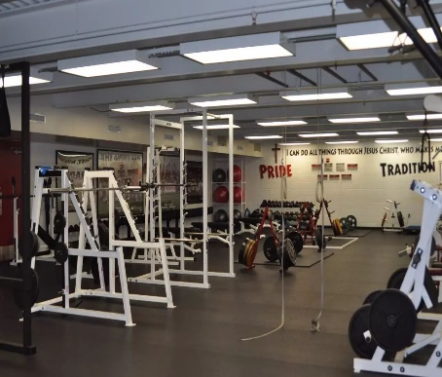
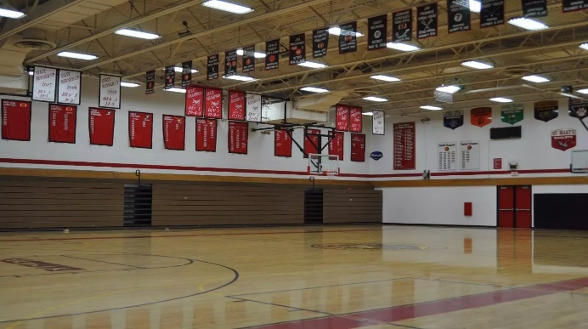
Impressive Facilities 顶尖设施
Boat House划船训练馆
Fitness center 健身房
Basketball Gym 篮球馆

Slide 14
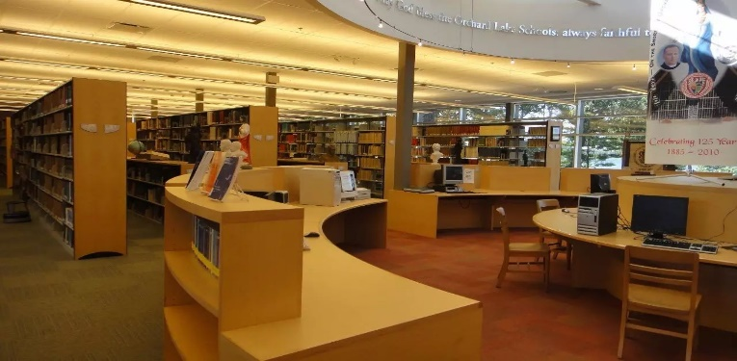
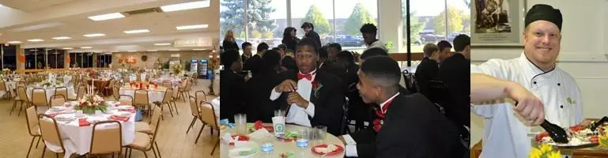
Impressive Facilities 顶尖设施
Library 图书馆
Dining Hall学生食堂

Slide 15
St. Mary’s Prep Boarding Program
圣玛丽男子高中寄宿项目
It is the mission of the St. Mary’s Preparatory Boarding Program to help develop our residents into men, men of character, integrity, and self-discipline based on the principle of Christian charity. The Boarding Program gives our students the opportunity to prepare; to enter college with the social skills, behavior skills and study habits necessary to be successful in a college setting or any other educational institution. Our primary goals as a staff is to help our students thrive academically, grow spiritually, develop personally, socially, emotionally, and physically.
出色卓越的寄宿条件，管理之规范，全美高中联盟最高水准之一！
寄宿目的不是拘束而是希望学生通过集体居住，生活，学习，与同龄人有更多沟通交流的机会。同时，与来自不同背景，文化，性格，成长环境的同学相互学习进步。
着重培养沟通、社交、独立、决策、包容、应变等能力，建立良好的学习习惯和生活习惯，为以后就读大学和走进社会并获得成功做好充足的准备。

Slide 16
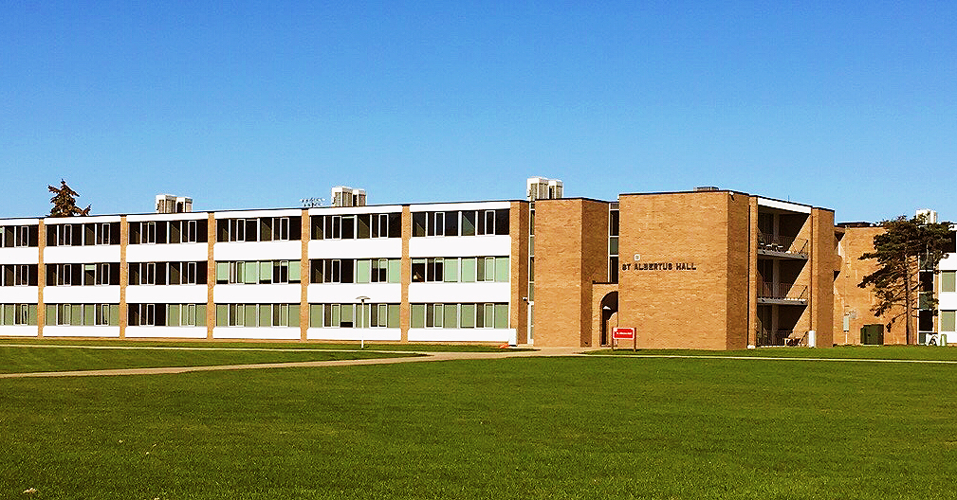
Dormitory寄宿制学校
双人间或单人间，三餐自助
充分利用校园资源
同龄人同住，更多共同语言
团队意识和独立自主的培养
监护人，有保障，24/7
Two bedrooms/ Single room
Easy access to campus resources and teachers
Provides students the opportunity to live with peers who share common interest; good for teamwork and being independent
Supervision = Safety

Slide 17
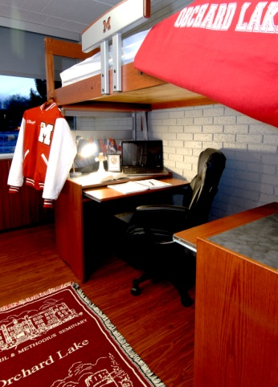
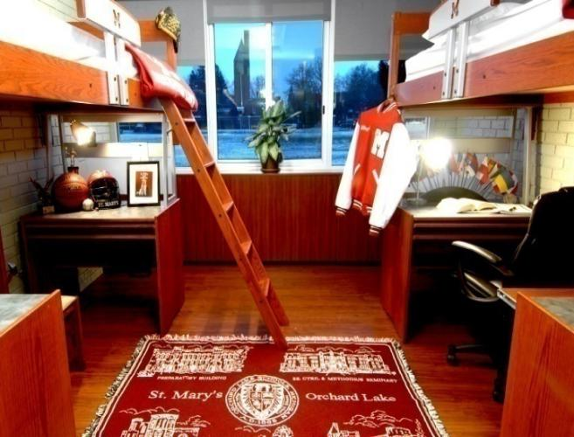
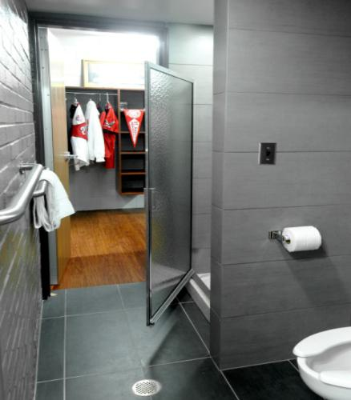
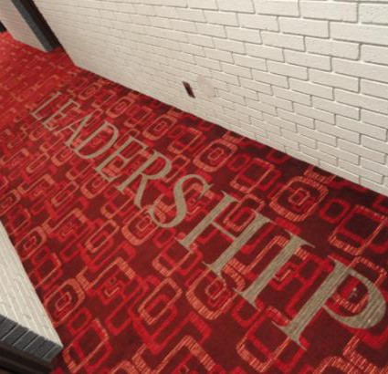
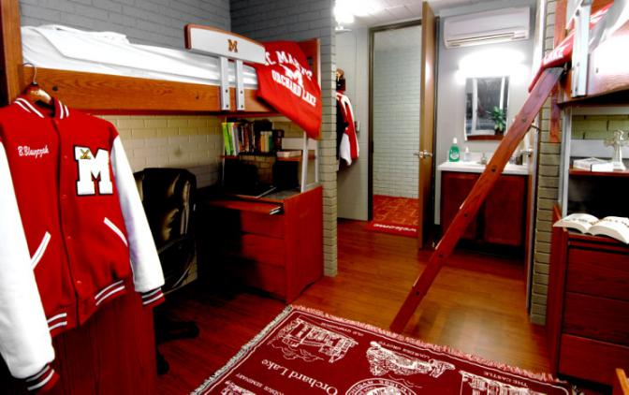
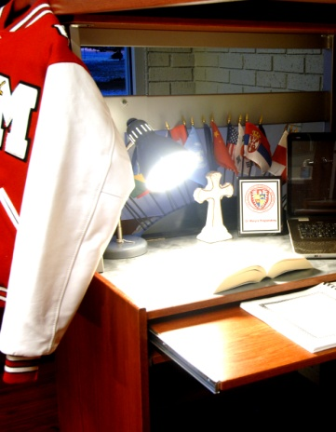
St. Mary’s PrepDormitory
学生宿舍
Standard Dorm Pictures 标准学生宿舍

Slide 18


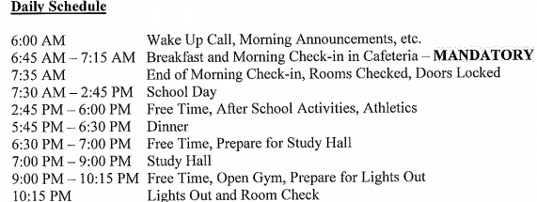
Dorm Schedule
宿舍作息表
宿舍日程表
6点 起床电话，早晨通知等
6：45-7：15 早餐-必须签到
7：35 早餐结束，清查并锁好房间
7：30-2：45 上课
2：45-6：00 晚餐
6：30-7：00 自由安排，准备参加晚自习
7：00-9：00 晚自习
9：00-10：15 自由安排，体育馆开放，准备熄灯
10：15 熄灯，宿舍检查

Slide 19
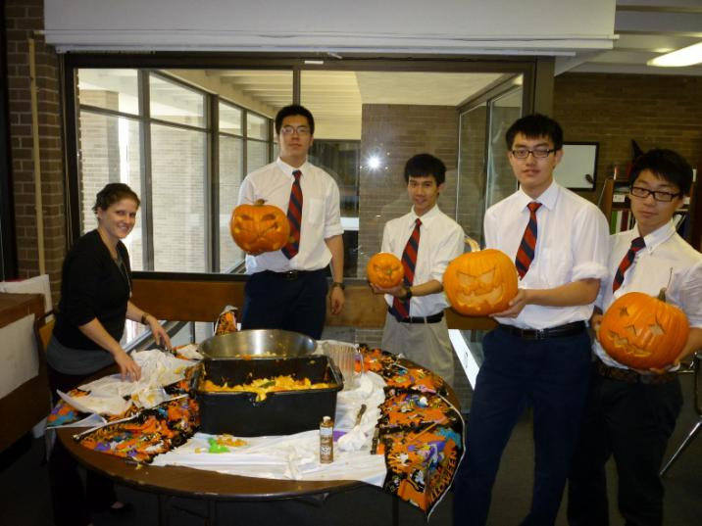
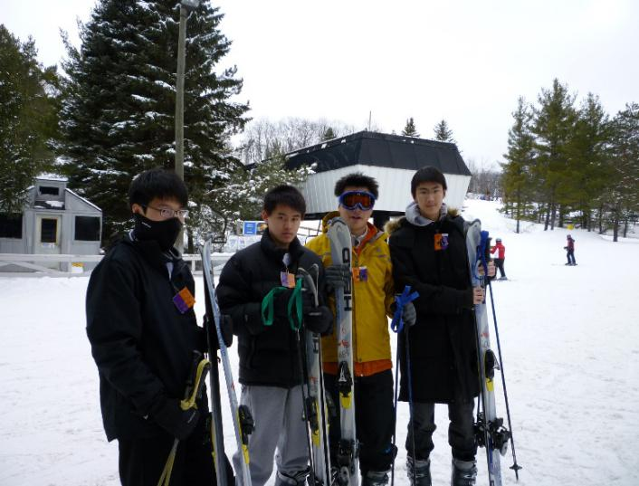
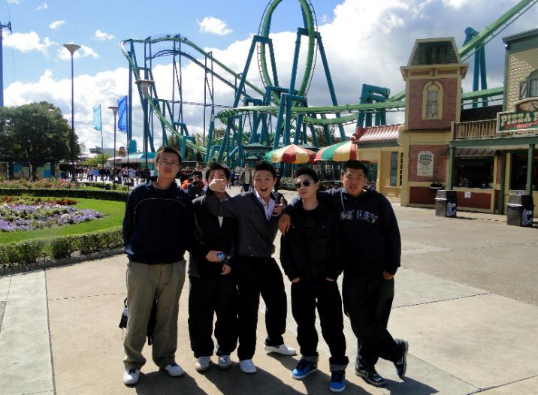
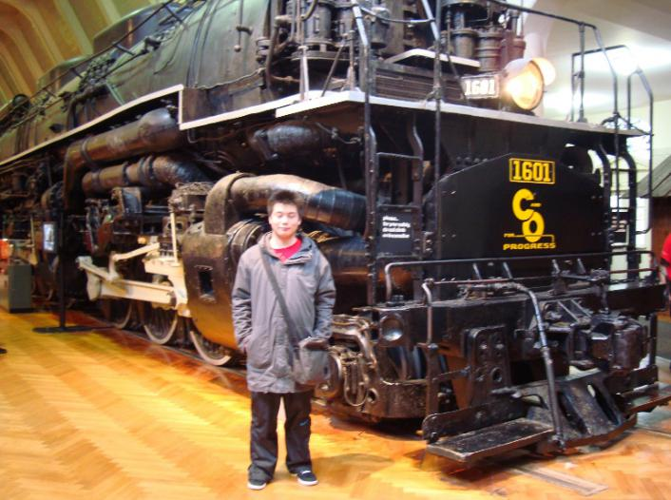
Boarding Program Activities
圣玛丽男子高中寄宿项目

Slide 20
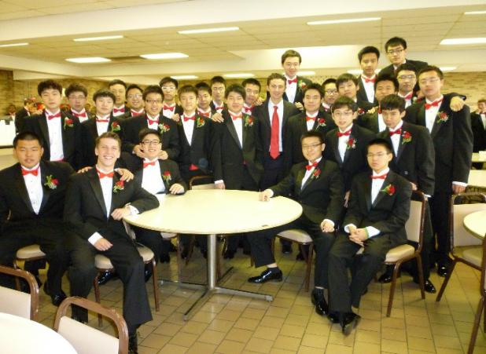
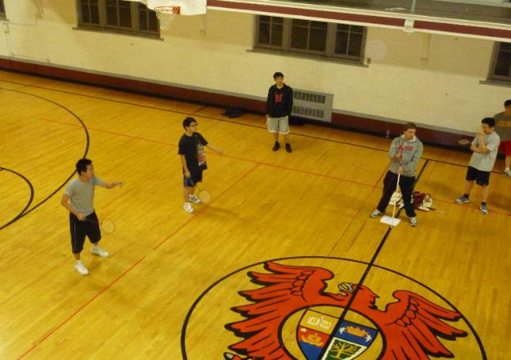
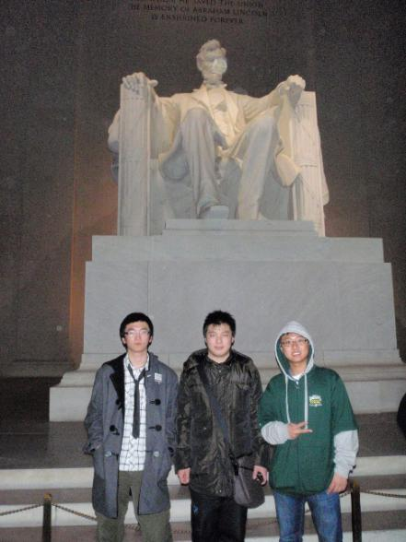
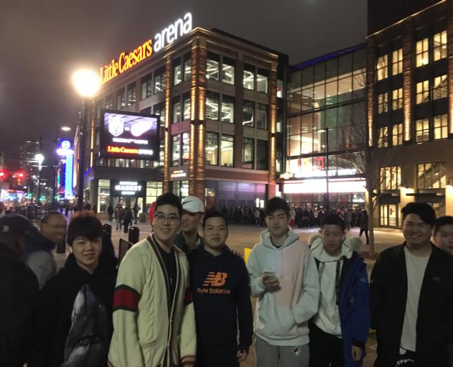
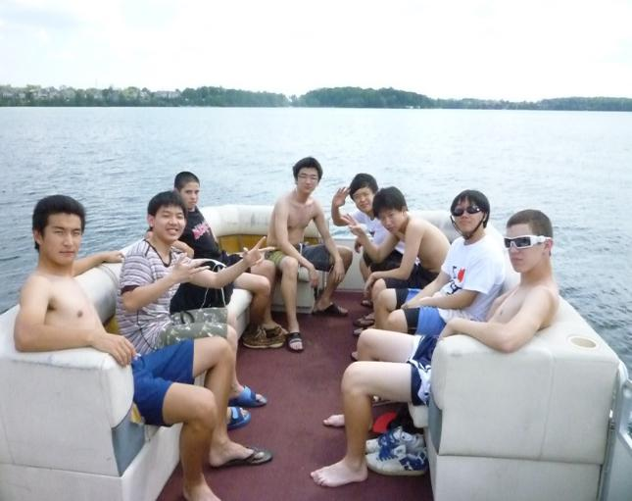
Boarding Program Activities
圣玛丽男子高中寄宿项目

Slide 21
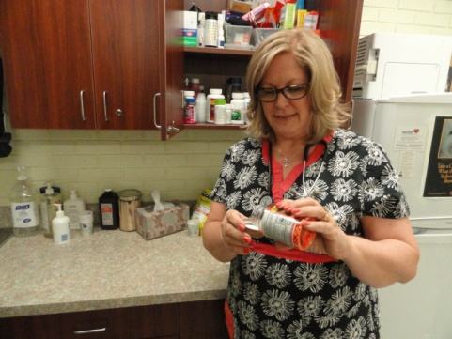
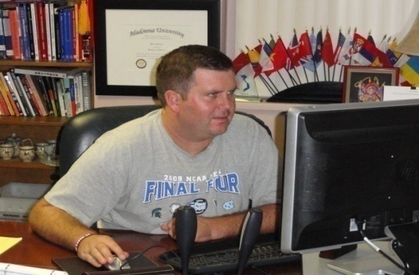
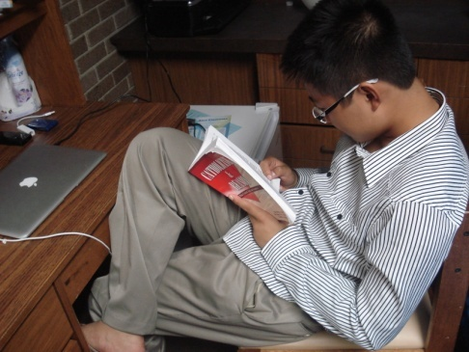
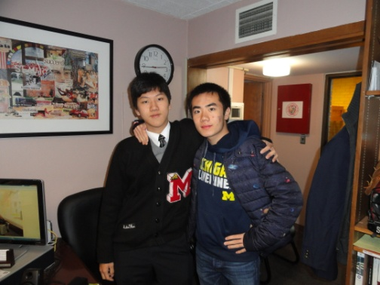
Boarding Program Activities
圣玛丽男子高中寄宿项目
寄宿项目工作人员：
寄宿生主任
寄宿生副主任
宿舍管理员
学生助理
全职校医
国际学生顾问
值班人员
Boarding program Staff:
Dormitory Supervisor
Dean of Residents
6 RAs & 6 SRAs
Full Time School Nurse
International Student Liaison

Slide 22
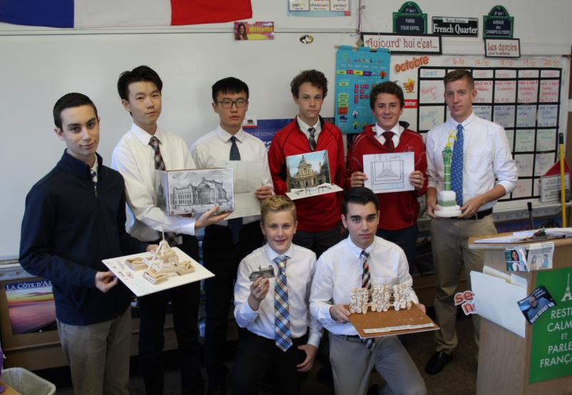
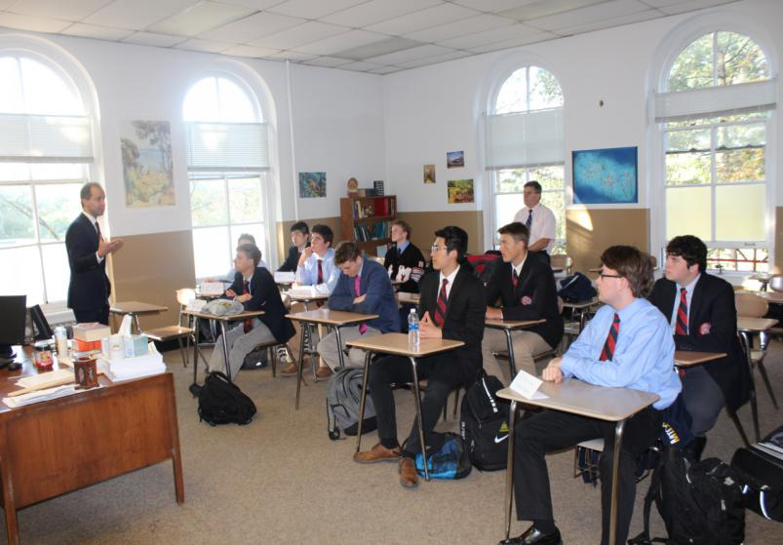
Academics学术信息
12 AP Courses
7 Honor Classes
6 Madonna University College Credits
ESL
课程严格把关，高标准要求
挑战性和参与性课堂

Slide 23
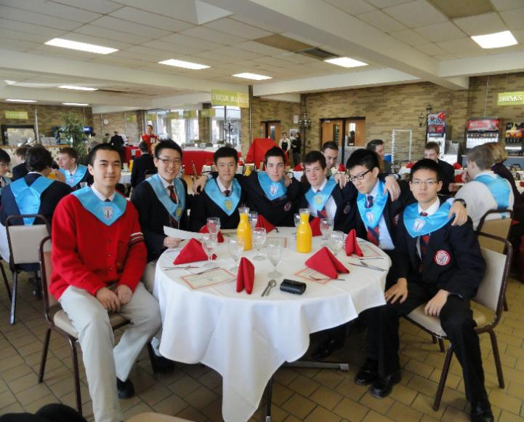
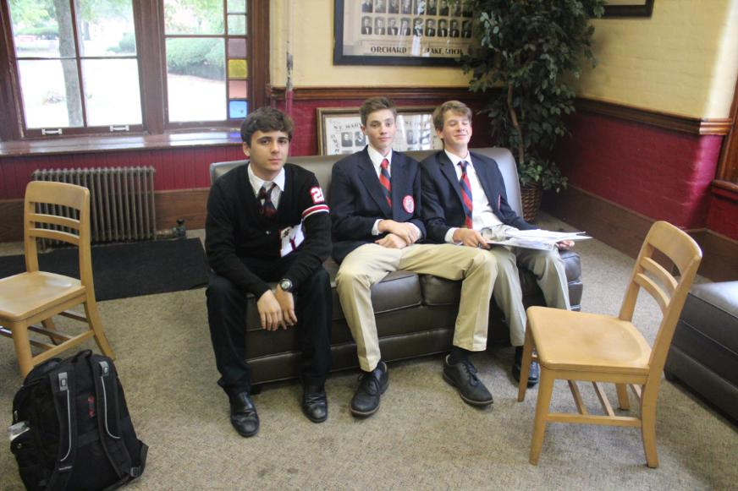
College Counseling升学辅导
圣玛丽男子高中有专门的升学辅导老师，针对不同年级的同学，给予一对一的关怀和指导
  大学对高中毕业生的要求
  标准化考试
  挑选学校
  大学访校
  升学准备提前规划准备
What do Colleges and Universities Look For
Standardized Test
  What is the ACT?
  Facts about the ACT
  Should I Send My ACT Score Directly to a School5
  What is the SAT? /Facts about the SAT:
Selecting the Right School
College Visits
College Timeline
Notes:
http://www.stmarysprep.com/pdfs/CollegePlanningGuide.pdf

Slide 24
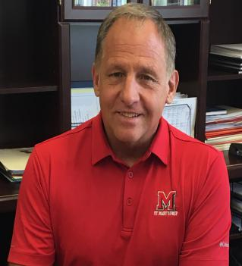
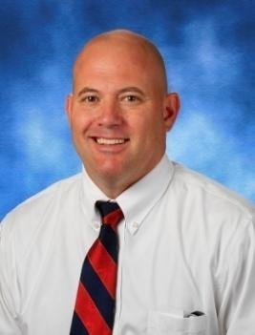
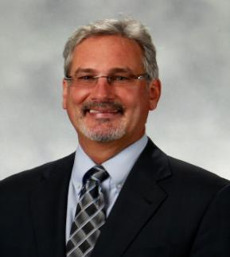
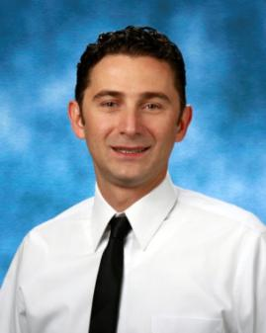
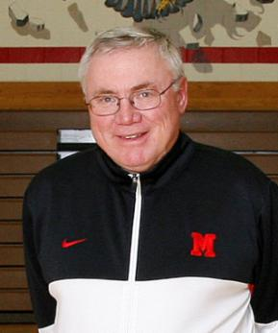
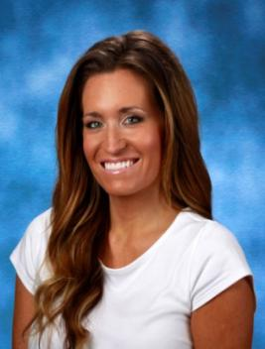
Administration行政管理
Headmaster
校长
Bob Pyles
Dean of Discipline
德育主任
Richard Rychcik
Dean of International Students & Business Manager
国际学生部主任
行政主管
Mirko Vukelic
H’14
School Psychologist
心理学教授
Dr. Thomas Kaiser
Athletic Director
体育主任
George Porritt
Dean of Admissions
招生主任
Candace Castiglione

Slide 25
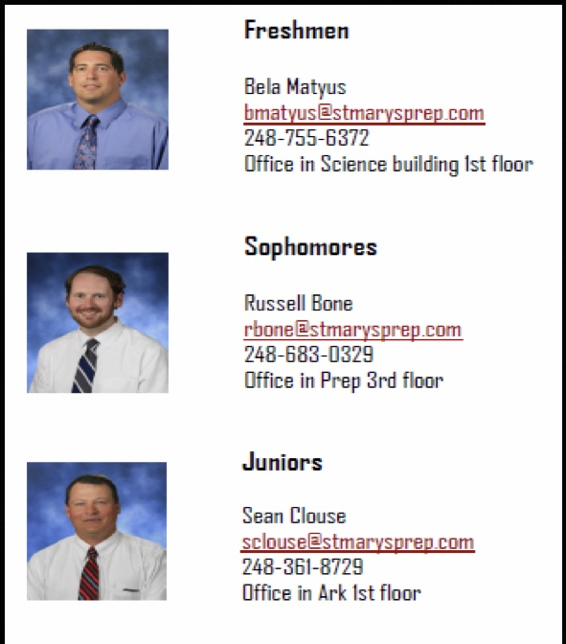
Academic Administration
学术支持
Counselor Corner. 指导教师咨询角
Net Classroom. 网络教室
Free Tutoring after school.免费课后辅导
College Visits. 大学参观访问
College Fair. 大学见面会
Naviance - College Planning Software
Naviance—— 大学规划软件
College Planning Guide. 大学规划指导
Career Symposium. 职业研讨会
Spiritual
Spiritual
Spiritual
Spiritual
Spiritual

Slide 26










College/UniversityAcceptance
毕业生就读大学
哈佛大学
普林斯顿大学
哥伦比亚大学
芝加哥大学
密歇根大学安娜堡分校
杜克大学
宾夕法尼亚大学
达特茅斯学院
西点军校
西北大学
圣母大学
华盛顿大学
布朗大学
纽约大学
波士顿学院
宾州州立大学
加州大学伯克利分校
波士顿大学
南加州大学
康涅狄格大学
加利福尼亚大学圣芭芭拉分校
威斯康星大学麦迪逊分校
等多所美国排名前60院校…

Slide 27
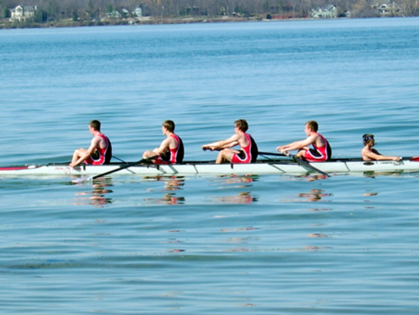




运动
Sports 体育运动
Sports
  棒球
  篮球
  越野
  田径
  摔跤
  美式足球
  高尔夫球
  长曲棍球
  英式足球
Golf
Crew
Soccer
Baseball
Wrestling
Lacrosse
Basketball
Football (USA)
Track & Field
Cross-Country
Hockey
Bowling
Snowboarding
Skiing

Slide 28





Sports 体育运动
Football 橄榄球
Ice Hockey 冰球
Golf 高尔夫
Rowing 划船

Slide 29





Sports 体育运动
Basketball 篮球
Baseball 棒球
Snowboarding 滑雪
Soccer 足球
Track 径赛

Slide 30
Athletics 体育及综合奖项
圣玛丽男子高中被选为天主教高中联盟 “2017年度学校”
St. Mary’s Prep was recognized as the Catholic High School League 2017 School of the Year
历年各项运动全州排名前十，截至2017年共赢得49次州冠军
田径队荣获2016年密歇根州高中体育协会比赛冠军
橄榄球队曾多次获密歇根州州冠军
冰球队密歇根地区冠军，州亚军
摔跤队荣获2017年区域冠军
划船队曾多次获州冠军
As of 2017, sports teams won 49 state championships
  Wrestling team won district champion in 2017
  Track and Field won 2016 MHSAA State Championship
  Football team won MI state championship 2014,2015,2016
  Rowing team won MI state championship 2017

Slide 31




Trophy奖杯

Slide 32




Arts艺术

Slide 33

Arts艺术
2017年，11年级的中国学生Harry Xia荣获“学术&艺术与写作-陶艺/玻璃制品”银奖，作品展出参观，父母及其艺术老师Christine Wilder都为他感到骄傲！
Congratulations to Prep junior Harry Xia on his Silver Key award in Ceramics/Glass in the Scholastic Art & Writing Awards sponsored by College for Creative Studies. His work is on display at CCS through March 3rd. Christine Wilder is his Prep art teacher!

Slide 34




Student Services
学生服务
Clubs
辩论社
学生会
网球社团
服务小组
数学俱乐部
钥匙俱乐部
取证俱乐部
学生互助辅导
乐队与合唱团
国家荣誉社团
机器人俱乐部
乒乓球俱乐部
全球领导俱乐部
国际象棋俱乐部
反酒后开车联盟
模拟法庭和辩论俱乐部
俱乐部
SADD
Robotics
Math Club
Clays Club
Chess Club
Guitar Club
Fishing Club
Squires Club
Student Council
Rock Climbing Club
Intramural Basketball
National Honor Society
Notes:
https://www.flickr.com/photos/137193094@N03/albums

Slide 35




Robotics Team
机器人战队
Clubs
俱乐部

Slide 36

A Boys School Advantages
男校优势
男生和女生在思维、体能、兴趣、行动力等诸多方面也的确存在显著的差异，因此建校的初衷之一便是正视并重视这种差异，并以此为基础，专注对男生的能力与潜力进行良性的综合开发。
因为校内学生性别单一，一些在男女混合学校中常见的问题，发生的概率要低很多，社会压力也相对较弱，由是，学生更能一心一意的投入到学习中，在同性的良性竞争下专注于自身各项能力的提高。
无论是教学体系、兴趣培养体系，还是课程设置、能力锻炼，全都是根据男生的需求量身打造，不见冗余，且更能激发男生的热情和积极性。
Boys learn differently from girls. Teachers in a boys' school understand how a boy learns and as a result are quite successful in implementing the special teaching techniques required to achieve optimal results.
The social pressures are much less stressful. Learning how to cope with and relate to girls on a daily basis in a coeducational setting causes added stress in those early adolescent years. That's exactly the time a boys' school is able to jump in and build confidence without the social distractions inherent in a mixed setting.
Boys learn that there are many routes to manhood. Traditional stereotypes can be dismantled and replaced by a more thoughtful approach to maturation, but not every boy can be a star athlete or a math whiz, strong bonds of friendship, teamwork and social interaction are what matter most in later life.

Slide 37


A Boys School Advantages
男校优势

Slide 38




A Boys School Advantages
男校优势

Slide 39

Conclusion 结语
  Here at Orchard Lake St. Mary’s Preparatory, we are always trying to get better and provide a better learning environment for all our students.
  在圣玛丽男子高中，我们会不断进取的努力为所有学生提供更优质的学习环境。
  “Your sons success is our greatest achievement”
  “您孩子的成功就是我们最大的成就”

